Slide 1
Lesson 3: Conditional column calculations and sub-setting rows
A Short Course to Learn SQL Basics
Kevin Patrick
Ryan Kuhns
Michael Headlee

Slide 2
Course Outline
Intro to SQL and relational databases
Functions and sorting data
Conditional column calculations and subsets of rows
Combining data from multiple tables
Summarizing data across rows (i.e.: grouping)
Using subqueries
Review of lessons 1-6 and examples with more complex functions
Stored procedures and parameters
Modifying and maintaining data
Overall review and real world and student submitted examples

Slide 3
Course Outline
Intro to SQL and relational databases
Functions and sorting data
Conditional column calculations and subsets of rows
Combining data from multiple tables
Summarizing data across rows (i.e.: grouping)
Using subqueries
Review of lessons 1-6 and examples with more complex functions
Stored procedures and parameters
Modifying and maintaining data
Overall review and real world and student submitted examples

Slide 4
The case expression
Allows you to apply If…Then…Else logic
The simple format:
Select
Case ColumnName
When Value1 Then Result1
When Value2 Then Result2
…additional when-then clauses….
[Else DefaultValue]
End as NewVar
Notes:
We use the case expression perform conditional logic on a column. The blue keywords are needed to fully define a case statement.
If the value after the when statement is true, then the result after the then statement is utilized.
The else statement is optional, but tends to be useful.
All case statements are finished with and end statement

Slide 5
An example of the simple case statement
Input table: Commodities
CommodityID | CategoryID | CommodityName
1 | L | Hogs
2 | F | Oranges
3 | F | Grapes
4 | V | Lettuce
Query:
Select
Case CategoryID
When ‘F’ Then ‘Fruit’
When ‘V’ Then ‘Vegetable’
Else ‘Other’
End as Category,
CommodityName
From Commodities
Output table:
Category | CommodityName
Other | Hogs
Fruit | Oranges
Fruit | Grapes
Vegetable | Lettuce
Notes:
We use the case expression perform conditional logic on a column. The blue keywords are needed to fully define a case statement.
If the value after the when statement is true, then the result after the then statement is utilized.
The else statement is optional, but tends to be useful.
All case statements are finished with and end statement

Slide 6
The searched format case statement
Select
Case
When Condition1 Then Result1
When Condition2 Then Result2
…additional when-then clauses….
[Else DefaultValue]
End as NewVar

Slide 7
Simple format vs. Searched format
Input table: Commodities
CommodityID | CategoryID | CommodityName
1 | L | Hogs
2 | F | Oranges
3 | F | Grapes
4 | V | Lettuce
Simple format:
Searched format:
Select
Case CategoryID
When ‘F’ Then ‘Fruit’
When ‘V’ Then ‘Vegetable’
Else ‘Other’
End as Category,
CommodityName
From Commodities
Select
Case
When CategoryId = ‘F’ Then ‘Fruit’
When CategoryId = ‘V’ Then ‘Vegetable’
Else ‘Other’
End as Category,
CommodityName
From Commodities
Both yield the same result
Notes:
We use the case expression perform conditional logic on a column. The blue keywords are needed to fully define a case statement.
If the value after the when statement is true, then the result after the then statement is utilized.
The else statement is optional, but tends to be useful.
All case statements are finished with and end statement

Slide 8
Sub-setting rows of data
We can think about sub-setting data in three different ways
By position (with “Top” keyword or Offset-Fetch filtering)
Uniqueness (with “Distinct” keyword)
Row-based logic (with Where clause)

Slide 9
Sub-setting based on position
Last week we used the “Top” keyword in a select statement
Select Top 50 Col1, Col2
From TableName
This is specific to MS SQL Server
ANSI standard is to use Offset – Fetch filtering
This syntax is specified in the order by statement

Slide 10
Sub-setting based on position: Example
Input table: Commodities
CommodityID | CategoryID | CommodityName
1 | L | Hogs
2 | F | Oranges
3 | F | Grapes
4 | V | Lettuce
Using “Top” keyword:
Using Offset-Fetch filtering:
Select Top 2 CommodityID, CategoryID, CommodityName
From Commodities;
Select CommodityID, CategoryID, CommodityName
From Commodities
Order By CommodityID
Offset 0 Rows Fetch Next 2 Rows only;
Both yield the same result, but Offset-Fetch filtering is ANSI standard.
Notes:
We use the case expression perform conditional logic on a column. The blue keywords are needed to fully define a case statement.
If the value after the when statement is true, then the result after the then statement is utilized.
The else statement is optional, but tends to be useful.
All case statements are finished with and end statement

Slide 11
Sub-setting based on uniqueness: Example
Input table: Commodities
CommodityID | CategoryID | CommodityName
1 | L | Hogs
2 | F | Oranges
3 | F | Grapes
4 | V | Lettuce
Using “Distinct” keyword:
Select Distinct CategoryID
From Commodities;
Select Distinct CategoryID, CommodityName
From Commodities;
CategoryID
F
L
V
CategoryID | CommodityName
L | Hogs
F | Oranges
F | Grapes
V | Lettuce

Slide 12
Components of a SQL Query
Select
From
<Where>
<Group By>
<Having> <Order By>
Statements in SQL query must appear in this order.
Statements with <> are optional. Include only those necessary for your query.

Slide 13
Components of a SQL Query
Select
From
<Where>
<Group By>
<Having> <Order By>
Tells SQL which existing or calculated columns to return
Tells SQL where to query data from
Subset rows of data

Slide 14
How SQL processes your query
You specify:
Select
From
Where
SQL processing order:
From
Where
Select

Slide 15
Where Clause Operators
Where Operator | Meaning
= | Equals
<> | Does not equal
> | Greater than
< | Less than
>= | Greater than or equal to
<= | Less than or equal to
This list contains the basic operators that can be used in the Where clause to return specific rows.

Slide 16
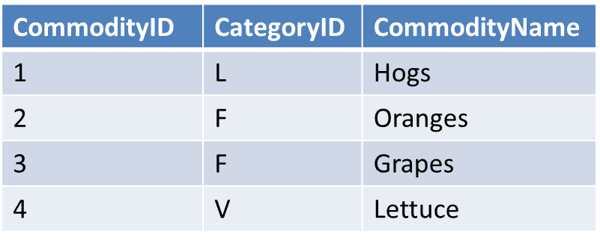
Simple Where Clause: Example 1
Input table: Commodities
Query:
Output table:
Select CommodityID, CategoryID, CommodityName
From Commodities
Where CommodityName=‘Oranges’;
CommodityID | CategoryID | CommodityName
2 | F | Oranges

Slide 17
Simple Where Clause: Example 2
Input table: Commodities
Query:
Output table:
Select CommodityID, CategoryID, CommodityName
From Commodities
Where CommodityID=2
And CategoryID=‘F’;
CommodityID | CategoryID | CommodityName
2 | F | Oranges

Slide 18
Precedence Among Operators
Rank | Operator
1. | ()Parentheses
2. | *Multiplication, / Division
3. | + Positive, - Negative, + Addition,- Subtraction + Concatenation,
4. | =,>,<,>=,<=,<>,!=,!>,!< Comparison Operators
5. | NOT
6. | AND
7. | Between, In, Like, Or
This list describes the order that SQL Server evaluates the operators in an expression.

Slide 19
Compound Where Clause: Example 1
Input table: Commodities
Query:
Select CommodityID, CategoryID, CommodityName
From Commodities
Where CategoryID=‘F’
And CommodityID in(3)
Or CategoryID=‘V’
And CommodityID in(4);
Output table:
CommodityID | CategoryID | CommodityName
2 | F | Grapes
4 | V | Lettuce
The logical statements connected by “And” operators take precedence.
Then the “Or” returns the combined result.

Slide 20
Compound Where Clause: Example 2
Input table: Commodities
Query:
Select CommodityID, CategoryID, CommodityName
From Commodities
Where (CategoryID=‘F’
And CommodityID in(3))
Or (CategoryID=‘V’
And CommodityID in(4));
Output table:
CommodityID | CategoryID | CommodityName
2 | F | Grapes
4 | V | Lettuce
It’s best practice to use parenthesis to explicitly control operator order.
It makes your code easier to read.

